Slide 1
URD Database Project
Update
October 11, 2026

Slide 2
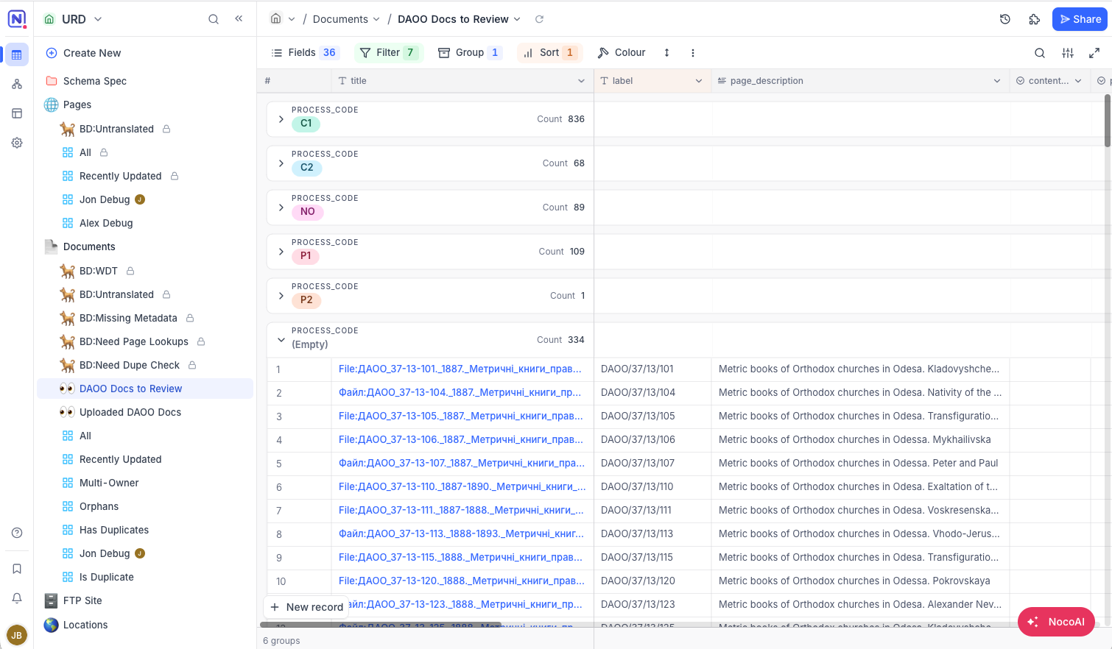
Goal: Replace Spreadsheets with a Unified Database
Scales with project needs
Resilient to errors
Streamline workflows
Enables automation

Slide 3
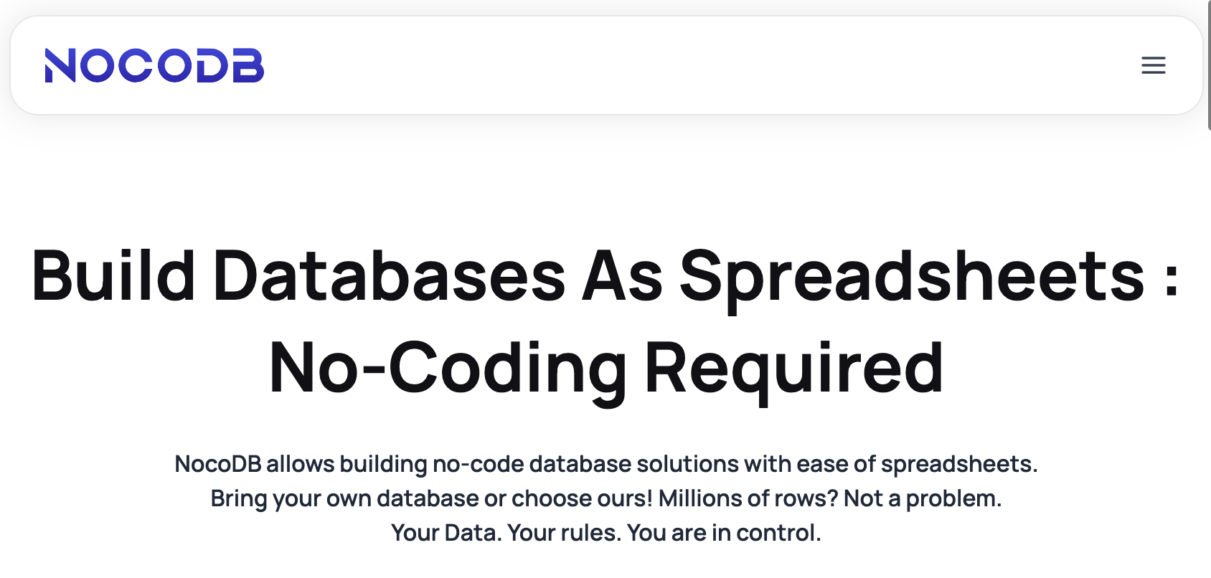
Candidate Database Platform: NocoDB
Low cost
Easy to learn (like AirTable)
Opensource
Open database
Available as hosted solution
Can be self-hosted too
https://nocodb.com/

Slide 4

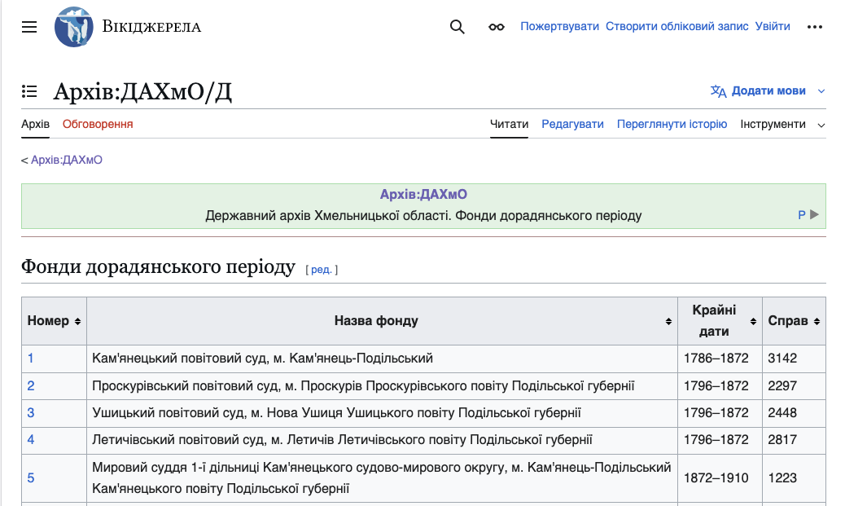
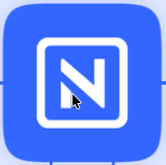
Birddog and the Database
Birddog web app
uk.wikisource.org
Nocodb Database

Slide 5
Funding
In August, JewishGen agreed to basic funding for the Database (~$5,000/year).
Up to 1 million records.
Four paid “editing” licenses.
Unlimited “view-only” licenses.
Limited feature access due to limited funding.
➔ This will require creating custom screens in Birddog to enable the URD workflow.

Slide 6



Development Status
Ongoing Work
Google Drive
Wikisource
Birddog
Snapshots
Birddog Integration - automatic updates from Wiki
Data import from spreadsheets
Database
Database Development
Workflow development (views, roles, streamlining)
Transition the URD process to the database platform

Slide 7
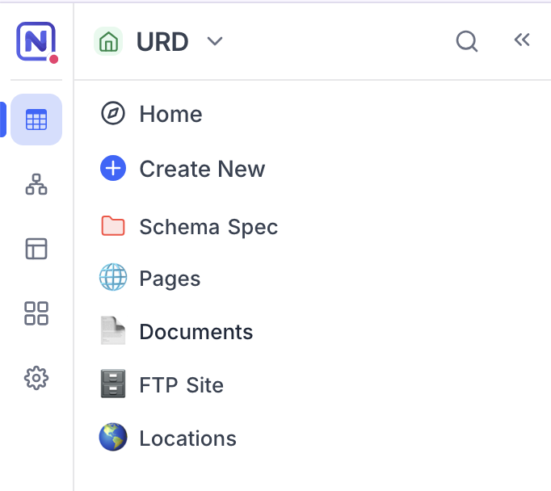
Peek into the Database

Slide 8
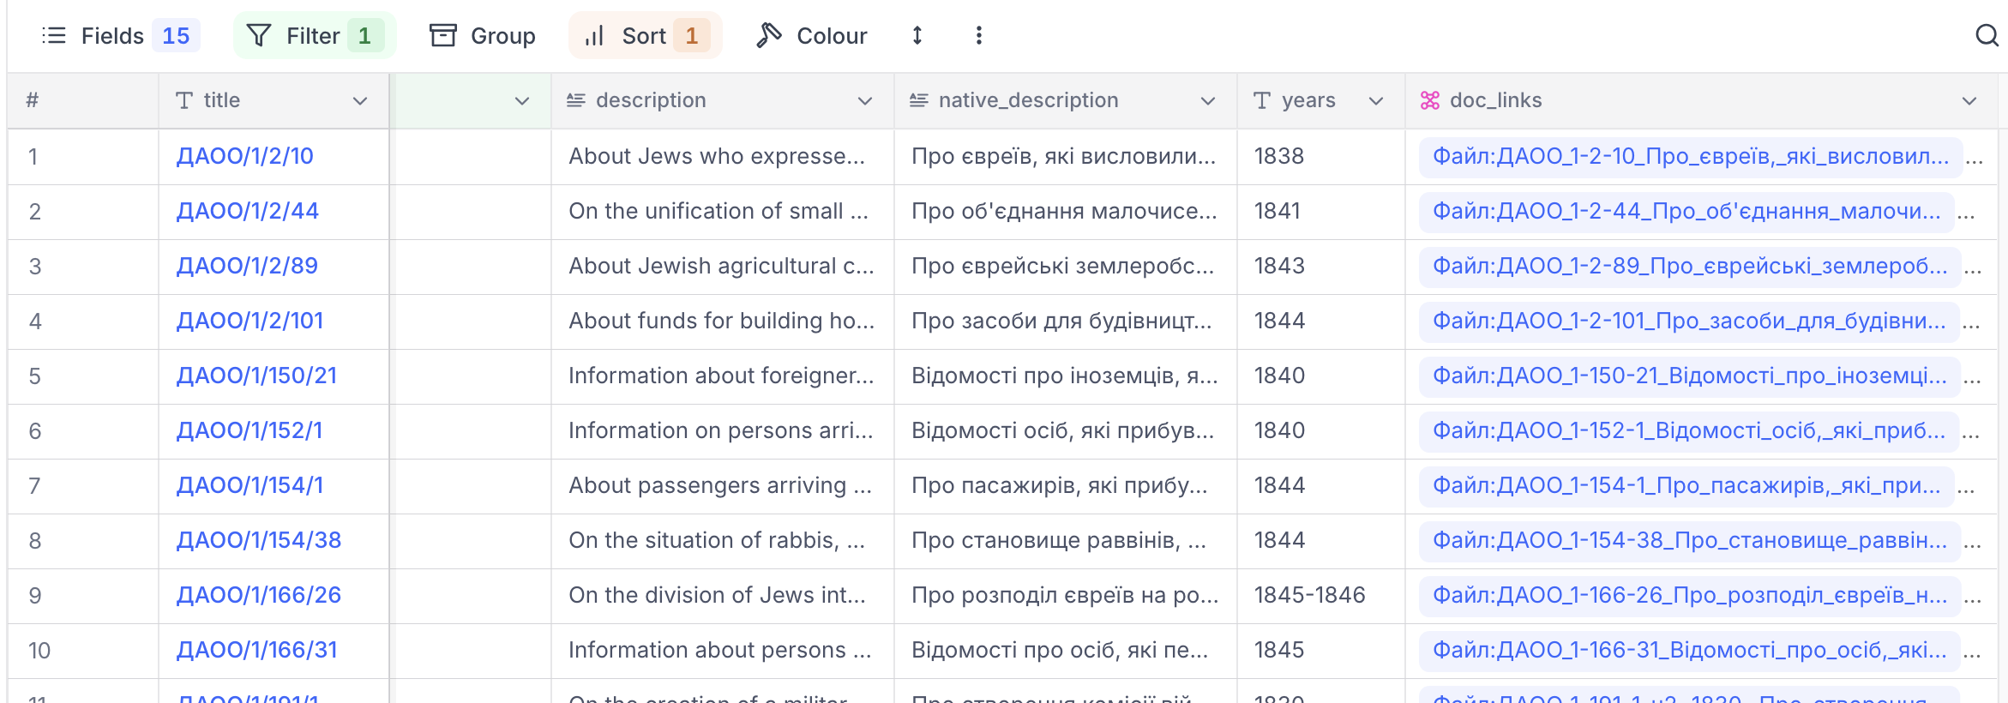
Peek into the Database
Each row represents information from a wiki page.
~400,000 page records

Slide 9
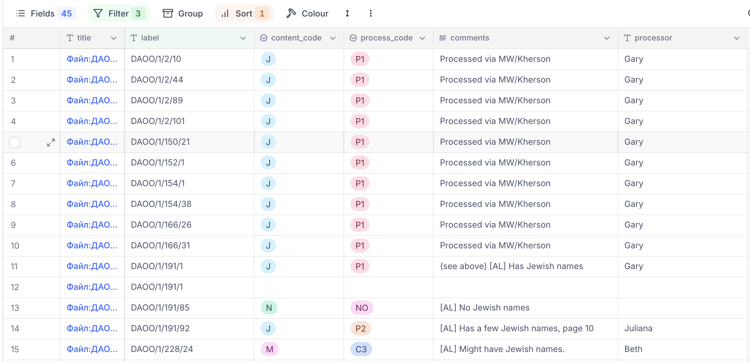
Peek into the Database
Each row represents information about a document (usually PDF).
~175,000 document records

Slide 10
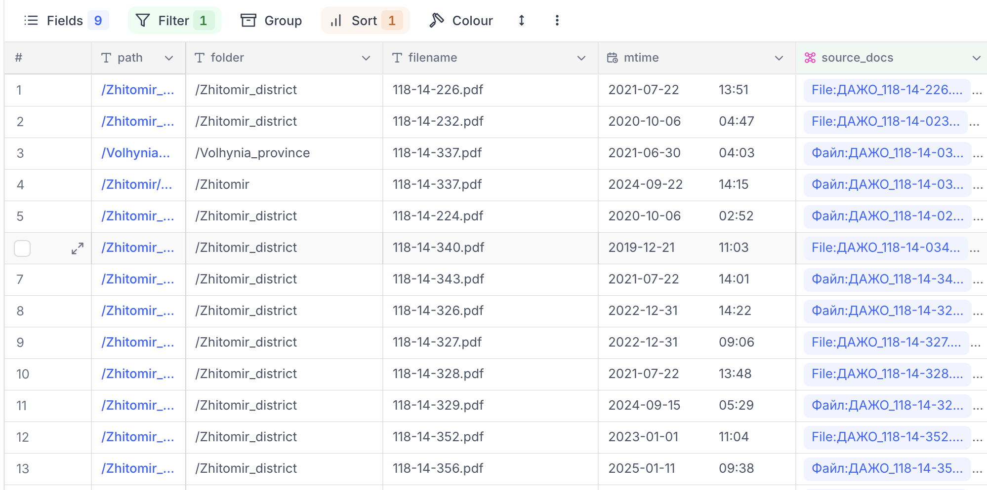
Peek into the Database
Each row represents an uploaded documented on the FTP site.

Slide 11
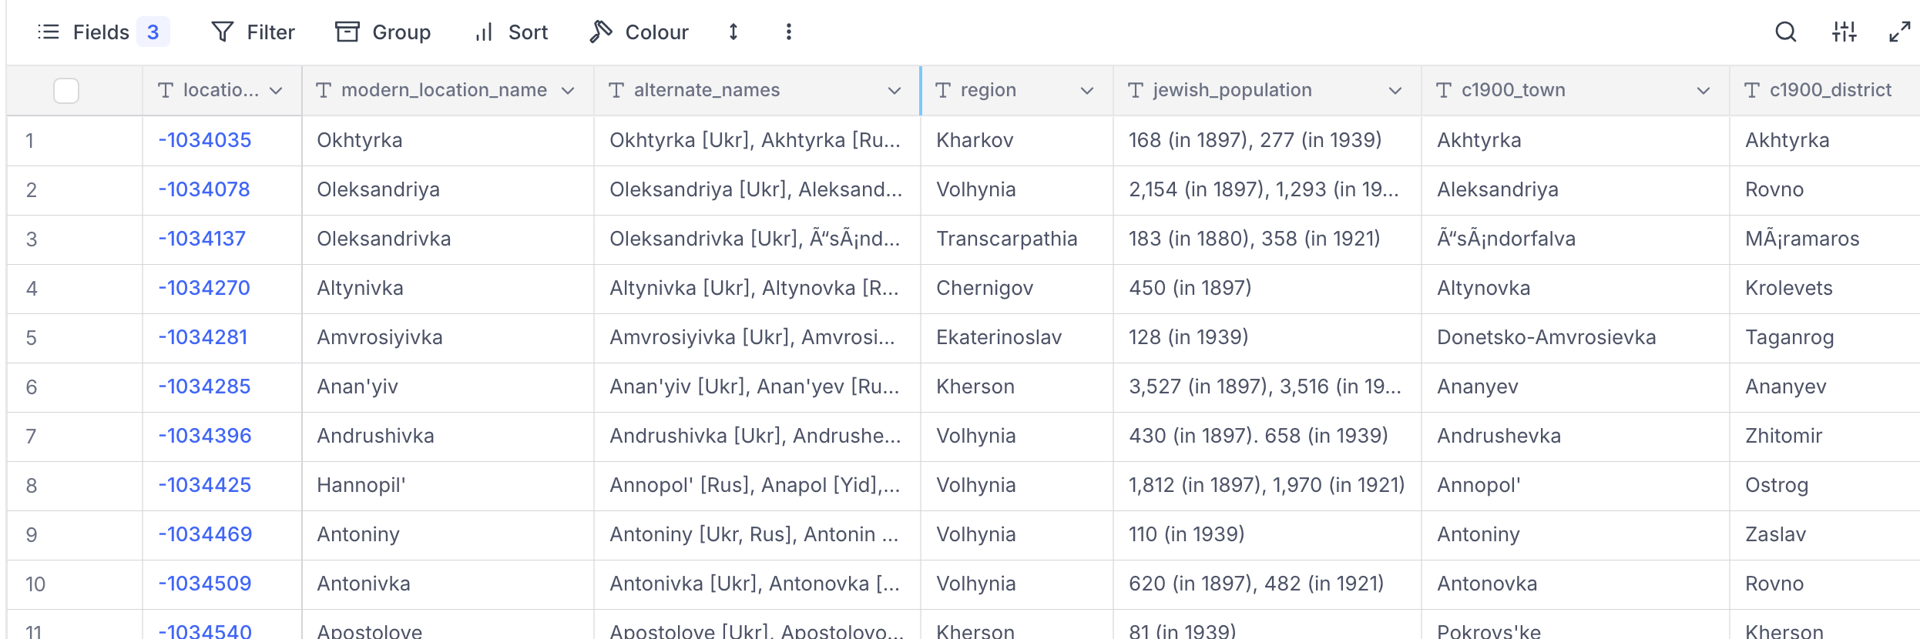
Peek into the Database
Each row represents a location in the JewishGen Communities database.

Slide 12
Next Steps
October-November:
Adjustments and improvements
Workflow development
December-January:
Team transition to database
Final import and freeze of all spreadsheets

